Slide 1

Project- NLP

Slide 2
INTRODUCTION
NLP Project for Disaster Tweet Classification –
To build a machine learning model capable of accurately classifying tweets as either related to real disasters or not. While some tweets may contain explicit keywords like "fire" or "flood," others may use such terms metaphorically or in a non-disaster context. Thus, the model needs to discern the true intent behind the language used in tweets, which can be nuanced and context-dependent.
we can enhance the ability to detect and respond to emergencies more efficiently. This project represents a valuable opportunity to leverage NLP techniques for the greater good, contributing to the advancement of disaster management and public safety efforts.

Slide 3
Tool & Technology
Tools – Python
Python Libraries- Pandas ,Matplotlib & Seaborn
• Pandas is a high-level data manipulation tool
• Matplotlib & Seaborn for graphical representation
Juypter Notebook - It is a web-based interactive computing platform. The notebook combines live code, equations, narrative text, visualizations.
Scikit-learn -- It is an open-source machine learning library that provides simple and efficient tools for data analysis and modeling.

Slide 4
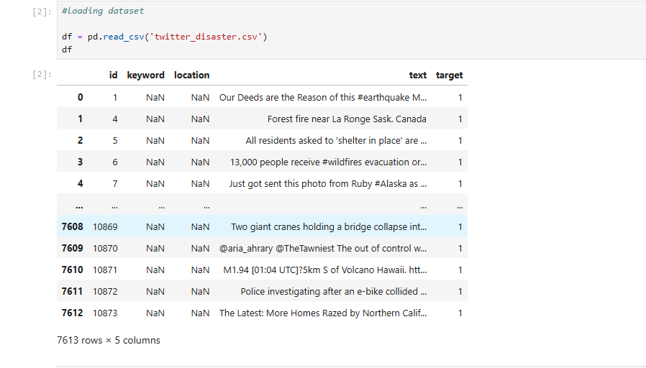
Data Exploration and Preparation
Load the datasets

Slide 5
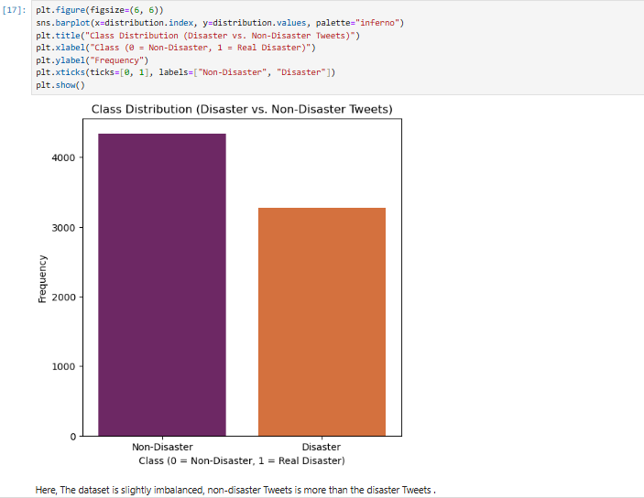
Data Exploration and Preparation
Distribution of classes (disaster vs. non-disaster tweets) using histograms or bar plots.

Slide 6
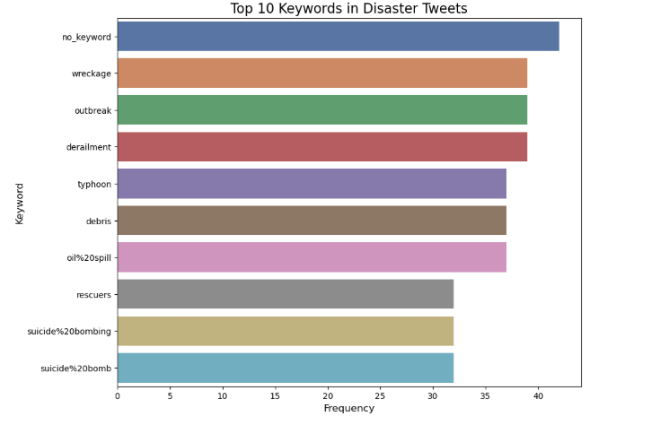
Data Exploration and Preparation
Analyze the frequency of keywords and phrases associated with disaster tweets.

Slide 7
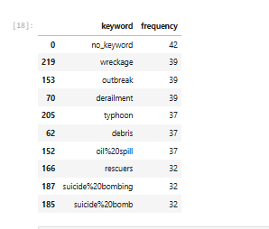
Data Exploration and Preparation
Analyze the frequency of keywords and phrases associated with disaster tweets.

Slide 8
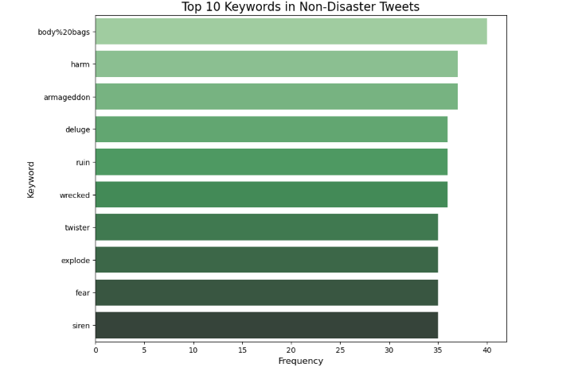
Data Exploration and Preparation
Analyze the frequency of keywords and phrases associated with Non-disaster tweets.

Slide 9
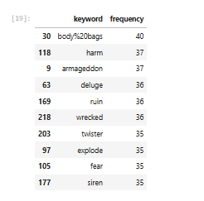
Data Exploration and Preparation
Analyze the frequency of keywords and phrases associated with Non disaster tweets.

Slide 10
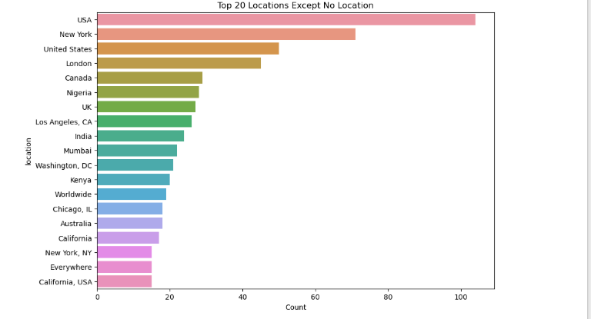
Data Exploration and Preparation
Top 20 Locations of tweets

Slide 11
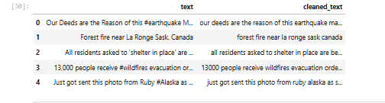
Data Exploration and Preparation
Cleaned text data

Slide 12
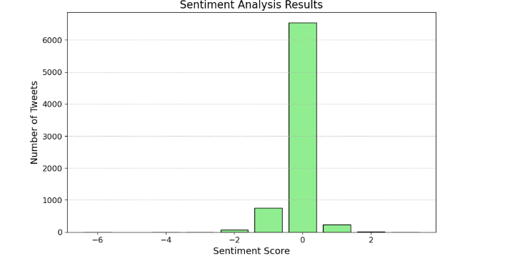
Feature Engineering and Model Selection
Extract relevant features from the text data, such as word frequencies, TF-IDF scores, and sentiment analysis

Slide 13
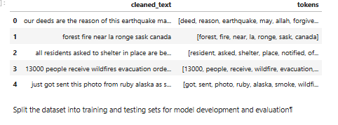
Feature Engineering and Model Selection
Tokenize the text into individual words or tokens

Slide 14
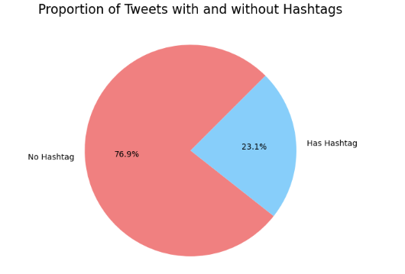
Feature Engineering and Model Selection
Tweets with Hastag & Non Hastag

Slide 15
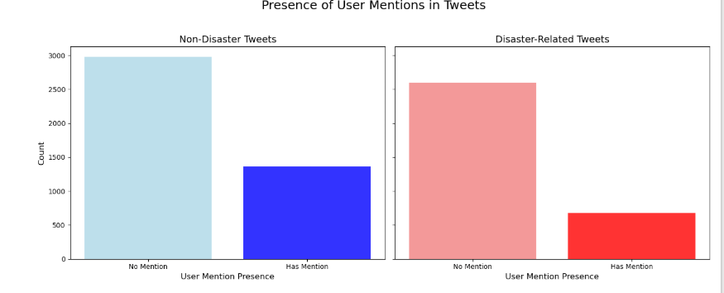
Feature Engineering and Model Selection
Presence of User Mentions in Tweets

Slide 16
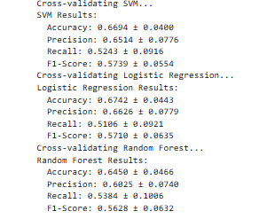
Model Evaluation and Validation
Output -

Slide 17
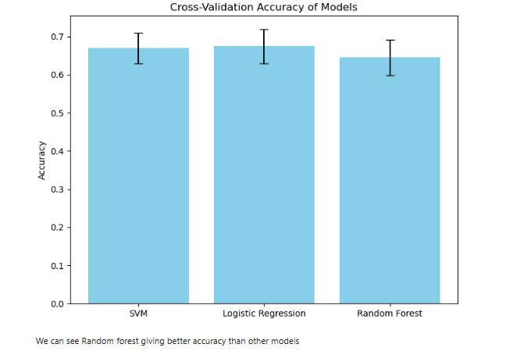
Model Evaluation and Validation
Output -

Slide 18
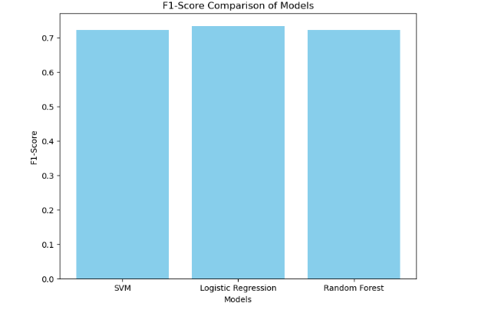
Model Evaluation and Validation
Evaluation -

Slide 19
Thank you
Name - Navdeep Kohar
E-mail – navdeepkohark58@gmail.com
Ph - 9888339255

